Slide 1
Terminai

Slide 2
Testavimas
Programinės įrangos tikrinimas siekant aptikti klaidas.
Niekad nesibaigia.
Neparodo kad nebeliko klaidų.
O gal nereikia testuoti?

Slide 3
What is Testing
Software testing consists of the dynamic verification that a program provides expected behaviors on a finite set of test cases, suitably selected from the usually infinite execution domain.
Dynamic: => executing the program on selected inputs.
Finite: testing is conducted on a subset of all possible tests, which is determined by risk and prioritization criteria.
Selected: => risk analysis techniques and software engineering expertise are applied.
Expected: It must be possible to decide whether the observed outcomes of program testing are acceptable or not.

Slide 4

Why Smart Engineers Write Bad Code
Today’s software engineers are master builders, and they are in danger of being overwhelmed.
Rock star status.
Successful self-taught programmers.
No Silver Bullet.

Slide 5
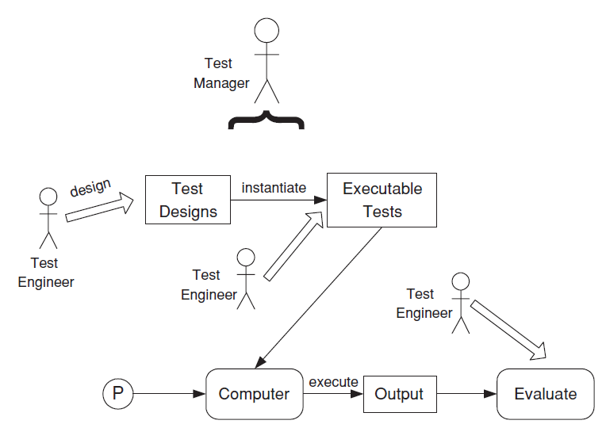
Kokybės užtikrinimo veiklos
Planuoti
Projektuoti
Vykdyti
Įvertinti

Slide 6
Testuotojo tikslai
… rasti klaidas
… kuo ankčiau progrmainės įrangos kūrimo procese
… užtikrinti kad jos būtų ištaisytos

Slide 7
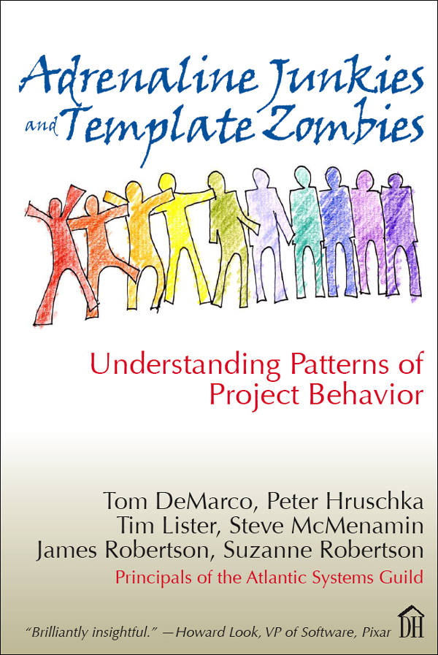
Kaip pagerinti kokybę
7. Mañana
11. Lease Your Soul
19. Film Critics
21. Soviet Style
50. The Empty Chair
60. Food++

Slide 8
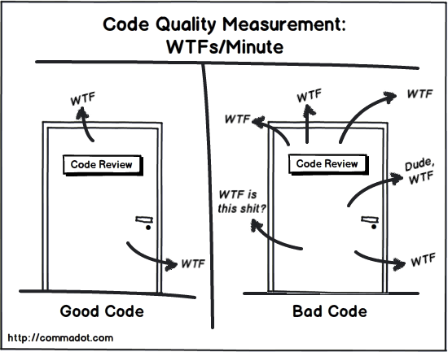
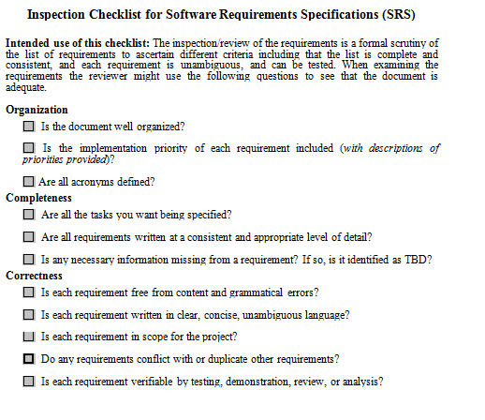
Statinis testavimas
Tinka net ir jei:
Nesikompiliuoja, nepasileidžia, nevykodoma
Kas tai:
Code Reviews.
Specifications Review.
Documentation Review.
Architecture Review.
…
Checklists!!! >>

Slide 9
Kodel reikia testuoti?
Sukurta programinė įranga nėra ideali.
Kodėl kūrėjai negali sukurti iškarto gerai?
Programinį įranga įgyja tiek daug “feature” ir turi veikt aibėje aplinkų darosi vis sunkiau ir sunkiau ja sukurti be defektų “defect/bug-free”

Slide 10
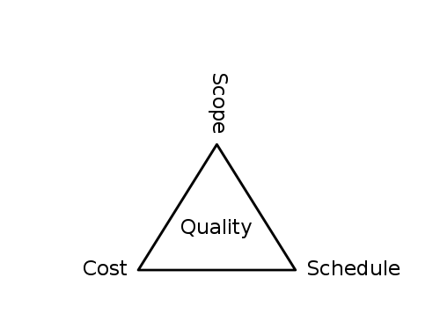
Kodėl nenori testuoti?
Cheap, Quick, High Quality -> pick 2.
Seen as activity w/o tangible output.
It’s expected to have quality stuff, but there not so much desire to pay for it.

Slide 11
Verification and Validation
Verification
Are we building the product right?
Validation
Are we building the right product?
Trust but Verify.
Verify but also Validate.

Slide 12
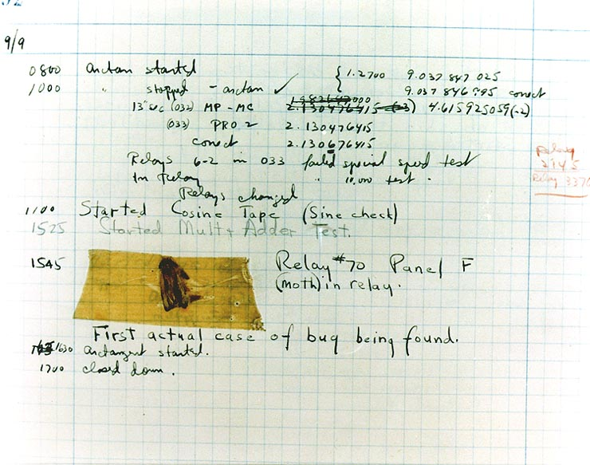
Bug

Slide 13
Fault -> Error -> Failure
Fault – defektas programinėje įrangoje
Error – bloga vidinė būsena, kuria įtakojo fault.
Failure – išorinė, neteisinga elgsena atsižvelgiant/lyginant su tikimasi būsena.

Slide 14
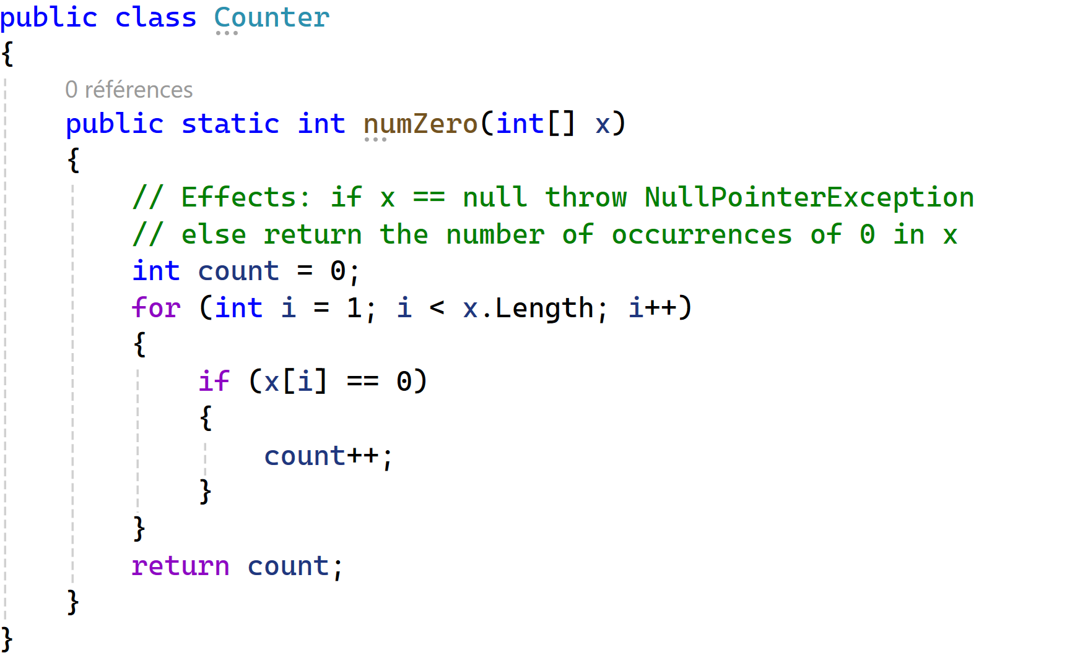
Fault -> Error -> Failure

Slide 15
Testing,Test Failure,Debugging
Testing – programinės įrangos įvertinimas stebint jos vykdymą/darbą.
Tests failure – vykdymas kuris iššaukia failure.
Debugging – fault paieška kai turimas failure.

Slide 16
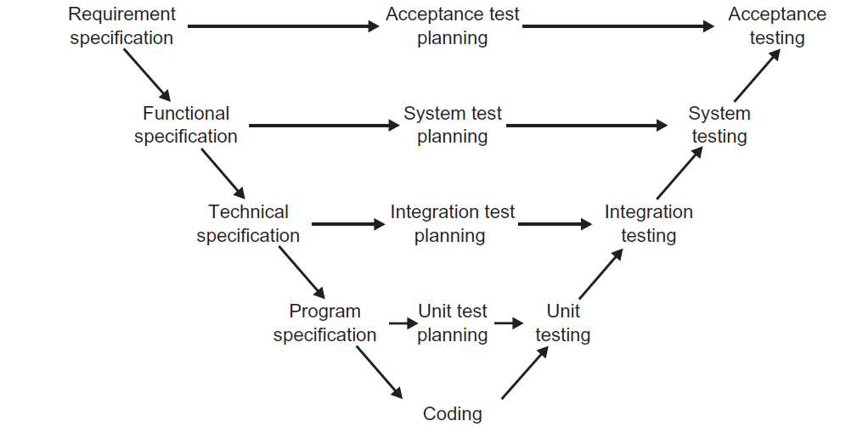
Testavimo lygiai
Notes:
Integration tests - > adax schedule extion tests… + system tests all in one

Slide 17
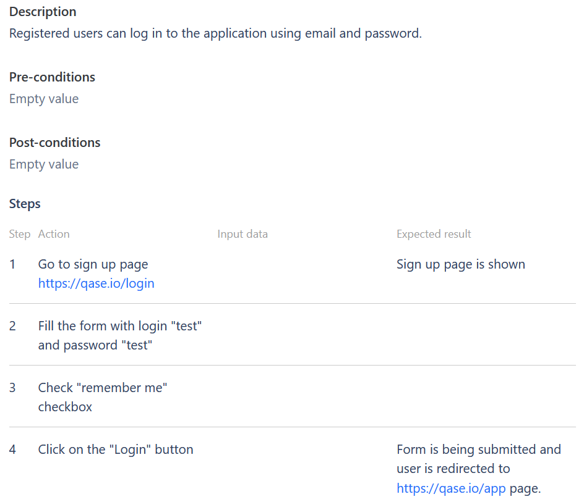
Testo sudėtis
Pradinė apibrėžta (ir nekintanti) sistemos būsena.
Testo vykdymo žingsniai (darbas su programa).
Laukiamas rezultatas (laukiama sistemos būsena, rezultatas)
Clean-Up

Slide 18
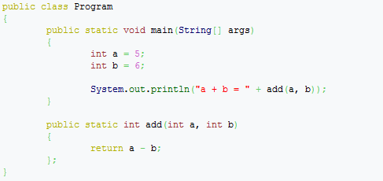
Hm..

Slide 19
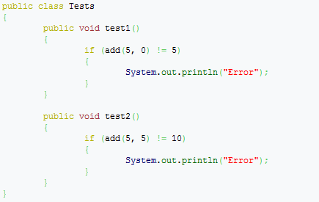
Geriau…

Slide 20
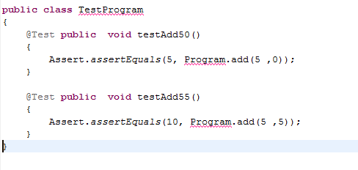
JUnit testas

Slide 21
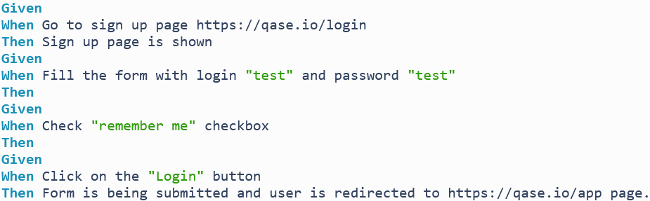
Naturalia kalba..

Slide 22
Test case
Test set – testų rinkinys (test cases set):
Tet case:
Test data – įėjimo duomenys
Prefix values – pradinė būseną (ir kaip ją pasiekti)
Postfix values – reikšmės perduodamos programinei įrangai testo vykdymo pabaigoje:
Verification values – patikrinti ar programa veikia korektiškai
Exit commands – užbaigti testą, pervesti į stabilią būseną.

Slide 23
Testavimo pabaiga
Coverage – padengimas
Užsibrėžiamas tikslas,
Kai jis pasiekiamas testavimas baigiamas
Kodo eilučių,
Vykdymo kelių
Operatorių
Reikalavimų
Įėjimo reikšmių.

Slide 24
Unit Testing
Mažiausios programos dalies testavimas:
Klasė
Metodas
Unit testavimo priemonės gali būti panaudotos:
Funkciniams testams
Apkrovimo testams
Kita.. (galima automatizuoti)

Slide 25
Taikinys-The Target of the Test
Unit Testing
Unit testing verifies the functioning in isolation of software elements that are separately testable.
Integration Testing
Integration testing is the process of verifying the interactions among software components.
Modern, systematic integration strategies are typically architecture-driven, which involves incrementally integrating the software components or subsystems based on identified functional threads.
System Testing
System testing is concerned with testing the behavior of an entire system.
Notes:
Integration tests - > adax schedule extion tests… + system tests all in one

Slide 26
Tikslas - Objectives of Testing
Acceptance / Qualification Testing
Acceptance / qualification testing determines whether a system satisfies its acceptance criteria, usually by checking desired system behaviors against the customer’s requirements.
Installation Testing
Often, after completion of system and acceptance testing, the software is verified upon installation in the target environment
Alpha and Beta Testing
Before software is released, it is sometimes given to a small, selected group of potential users for trial use (alpha testing) and/or to a larger set of representative users.
Reliability Achievement and Evaluation
Testing improves reliability by identifying and correcting faults. In addition, statistical measures of reliability can be derived by randomly generating test cases according to the operational profile of the software.
Regression Testing
In practice, the approach is to show that software still passes previously passed tests in a test suite.
Performance Testing
Verifies that the software meets the specified performance requirements and assesses performance characteristics—for instance, capacity and response time.
Notes:
Installation testing…. Aaaaa – ramunas must be proud… Cause, defect analysis -> procedure improvement… TMMi – level 5 :)
Sneaker net performance testing :)
Performance, subset – efficiency.

Slide 27
Tikslas - Objectives of Testing
Security Testing
Security testing verifies the confidentiality, integrity, and availability of the systems and its data. Negative testing.
Stress Testing
Stress testing exercises software at the maximum design load, as well as beyond it, with the goal of determining the behavioral limits, and to test defense mechanisms in critical systems.
Back-to-Back Testing
Testing in which two or more variants of a program are executed with the same inputs, the outputs are compared, and errors are analyzed in case of discrepancies.
Recovery Testing
Recovery testing is aimed at verifying software restart capabilities after a system crash or other “disaster.”
Interface Testing
Interface testing aims at verifying whether the components interface correctly to provide the correct exchange of data and control information.
Configuration Testing
In cases where software is built to serve different users, configuration testing verifies the software under different specified configurations.
Usability and Human Computer Interaction Testing
The main task of usability and human computer interaction testing is to evaluate how easy it is for end users to learn and to use the software.
Notes:
Security += audit. Access cntrol, comliance with laws,

Slide 28
Testavimo technikos
Based on the Software Engineer's Intuition and Experience
Ad Hoc
Exploratory Testing
Input Domain-Based Techniques
Equivalence Partitioning
Pairwise Testing
Boundary-Value Analysis
Code-Based Techniques
Control Flow-Based Criteria
Data Flow-Based Criteria

Slide 29
Testavimo technikos
Fault-Based Techniques
Error Guessing
Mutation Testing
Usage-Based Techniques
Operational Profile
User Observation Heuristics
Model-Based Testing Techniques
Decision Tables
Finite-State Machines
Formal Specifications
Workflow Models
Techniques Based on the Nature of the Application
Selecting and Combining Techniques
Combining Functional and Structural
Deterministic vs. Random

Slide 30
Testavimo matavimai
Evaluation of the Program Under Test
Program Measurements That Aid in Planning and Designing Tests (ex. lines of code)
Fault Types, Classification, and Statistics
Fault Density
Life Test, Reliability Evaluation (when to end testing)
Reliability Growth Models (are we in stabilization phase)
Evaluation of the Tests Performed
Coverage / Thoroughness Measures
Fault Seeding
Mutation Score

Slide 31
Q/A s.v.p.

